Slide 1
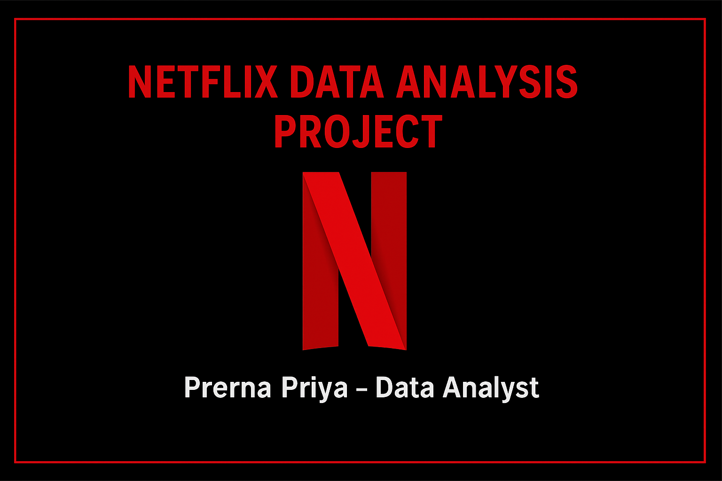
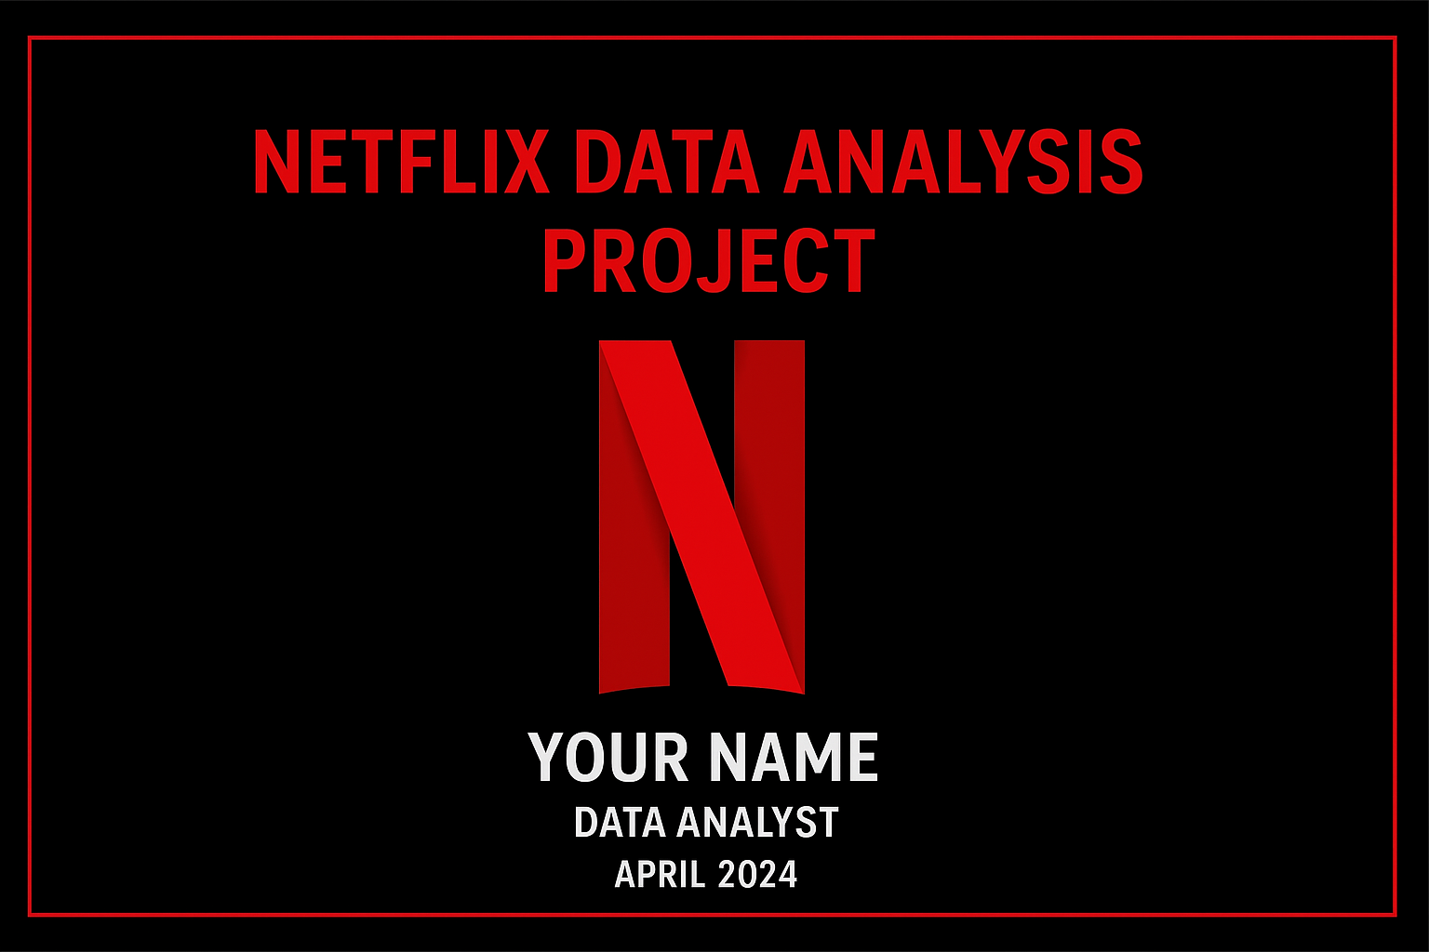
Netflix Data Analysis Project
Presented by: Prerna Priya
Role: Data Analyst
Date: 2025

Slide 2
Introduction
Netflix is a leading global streaming entertainment service, founded in 1997 by Reed Hastings and Marc Randolph. Initially launched as a DVD rental service, it transformed into a subscription-based online streaming platform in 2007.
Today, Netflix offers a wide range of movies, TV shows, documentaries, and original content (Netflix Originals) across multiple genres and languages. With over 270 million subscribers worldwide (2025), Netflix operates in more than 190 countries and is a pioneer in on-demand digital streaming, revolutionizing how people consume entertainment.Aim: Analyze Netflix dataset to uncover content trends, audience preferences, and business insights.

Slide 3
Objectives
- Identify trends in Movies vs TV Shows
- Analyze genres and countries
- Study release year distribution
- Extract business insights

Slide 4
Dataset Description
Source: Netflix Dataset (CSV from Kaggle/other)
Features:
- Title
- Director
- Cast
- Country
- Release Year
- Rating
- Genre
- Duration
- Type (Movie/Show)

Slide 5
Tools & Technologies
- SQL
- Python (Pandas, Matplotlib, Seaborn)
- Power BI / Tableau for visualization

Slide 6
Data Cleaning & Preparation
- Handle missing values
- Convert date formats
- Remove duplicates
- Standardize categorical values

Slide 7
Exploratory Data Analysis (EDA)
- Movie vs TV Show count
- Distribution by release year
- Top genres and countries

Slide 8
Visualizations
- Bar Chart: Movies vs TV Shows
- Line Chart: Content growth by year
- Map: Top producing countries
- Word Cloud: Genre popularity

Slide 9
Key Insights
- Movies dominate Netflix library (~70%)
- Content growth peaked between 2017–2019
- USA and India are top content producers
- Drama & Comedy are most common genres

Slide 10
Conclusion & Recommendations
- Expand regional content
- Increase focus on diverse genres
- Use data-driven decisions for future productions

